Slide 1
Warm Up/midterm review
1) Identify as chemical or physical change
a) A piece of wood sawed in half
b) Milk turns sour
c) Melted butter solidifies in the refrigerator
2) Describe some physical or chemical properties of something in the room
3) What are these units defining?
a. J
b. Kg/cm3
c. ML
d. ng
e. cm
4. Is the following data precise or accurate?
Jim had performed a lab where he measured the boiling point of water. His results reported.
1) 95.4°C 2) 95.2°C 3) 95.1°C 4) 95.4°C

Slide 2
Warm Up/midterm review
1) Explain Rutherford’s Gold Foil E
2) Describe some physical or chemical properties of something in the room
3) What are these units defining?
a. J
b. Kg/cm3
c. ML
d. ng
e. cm
4. Is the following data precise or accurate?
Jim had performed a lab where he measured the boiling point of water. His results reported.
1) 95.4°C 2) 95.2°C 3) 95.1°C 4) 95.4°C

Slide 3
Acetic acid is the important ingredient in vinegar. It is composed only of carbon (40.4%), hydrogen (6.71 %), and oxygen (53.28%). It molar mass is 60.1 g/mol. Determine the empirical and molecular formula of the acid.

Slide 4

Section 1 Describing Chemical Reactions
Chapter 8
Characteristics of Chemical Equations, continued
Word and Formula Equations
The first step in writing a chemical equation is to identify the facts to be represented.
A word equation is an equation in which the reactants and products in a chemical reaction are represented by words.
  A word equation is qualitative
  example: methane + oxygen carbon dioxide + water

Slide 5
Section 1 Describing Chemical Reactions
Chapter 8
Characteristics of Chemical Equations, continued
Word and Formula Equations, continued
The next step in writing a correct chemical equation is to replace the names of the reactants and products with appropriate symbols and formulas.
A formula equation represents the reactants and products of a chemical reaction by their symbols or formulas.
  example: The formula equation for the reaction of methane and oxygen is
  CH₄(g) + O₂(g) CO₂(g) + H₂O(g) (not balanced)

Slide 6
Section 1 Describing Chemical Reactions
Chapter 8
Characteristics of Chemical Equations, continued
Sample Problem B
Translate the following chemical equation into a sentence:
BaCl₂(aq) + Na₂CrO₄(aq) BaCrO₄(s) + 2NaCl(aq)

Slide 7
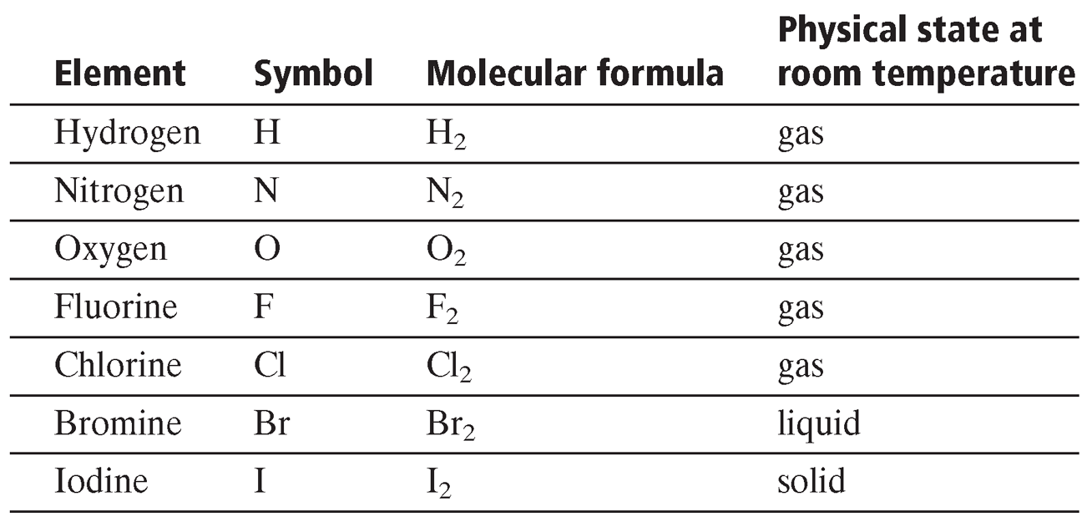
Elements That Normally Exist as Diatomic Molecules
Section 1 Describing Chemical Reactions
Chapter 8

Slide 8
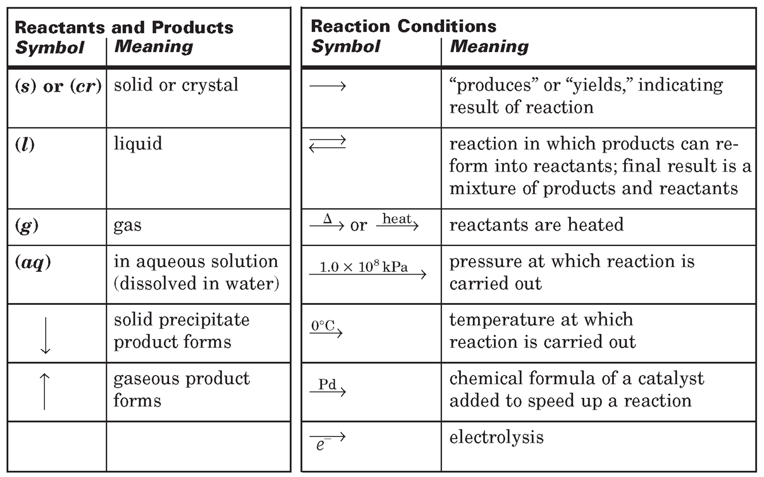
Symbols Used in Chemical Equations
Section 1 Describing Chemical Reactions
Chapter 8

Slide 9
Naming Acids
Does the formula begin with H?
Does the acid contain a polyatomic ion?
Is the name end in
-ate or -ite
Yes
No
The -ate changes to –ic.
H₂SO₄ Sulfuric Acid
The prefix is Hydro and the end of the second element is changed to ic
HCl is hydrochloric acid
The –ite changes to –ous.
HNO₂ Nitrous Acid

Slide 10
According to the Law of Conservation of Mass……matter can not be created or destroyed.
We use this rule when writing our chemical equations.

Slide 11
Chemical Equations are like recipes for cooking.
We have ingredients aka reactants and our products.
Cereal + Milk → Breakfast
H₂(g) + O₂(g) → H₂O(l)

Slide 12
When we write balanced equations:
atoms in the reactants = atoms in the products.
H₂ + O₂ →

Slide 13
How many atoms in the following
H₂SO₄
2. Al₂(SO₄)₃
2 Hydrogen, 1 Sulfur 4 oxygen
2 x Al, 3 x Sulfur, 12 x Oxygen

Slide 14
Today in Chemistry
Have out:
  Materials for notes
  Goggles
  HW
  1) HW Chemical Reaction Worksheet
  2) Empirical Formula lab write up due Monday

Slide 15
Today’s Goals
Review balancing equations
Learn to predict products of a chemical reaction
Learn to identify chemical reactions as one of the main 5 reaction types.
    Synthesis
    Decomposition
    Single Displacement
    Double Displacement
    Combustion

Slide 16
Is this equation balanced?
H₂(g) + O₂(g) → H₂O(l)
Count the atoms
Element | Reactant | Product
Hydrogen
2
2
NO! Not balanced
Oxygen
2
1

Slide 17
We balance reactions by using coefficients.
__H₂ +__O₂ →__H₂O
Adding coefficients is the only way to add atoms to an equation.
2
2
Remember to distribute the coefficient to all atoms in the compound
Element | Reactant | Product
Hydrogen
4
2
4
2
NO! Not balanced
Oxygen
2
1
2

Slide 18
Let’s try another
__K +__Cl₂ →__KCl
2
2
Element | Reactant | Product
Potassium
2
1
2
1
Chlorine
2
1
2

Slide 19
How many atoms of each element in the following?
  1) 5H₂
  2) 10H₂O
  3) 3Mg₃(PO₄)₂

Slide 20
Practice!
O₂ + PCl₃ → POCl₃

Slide 21
Section 1 Describing Chemical Reactions
Chapter 8
Characteristics of Chemical Equations, continued
Sample Problem A
If elemental chloride gas is bubbled through a solution of potassium iodide, the iodide ion is converted to elemental iodine, which may be recovered as a gray solid, leaving a solution of potassium chloride.
Write the balanced equation and identify the reaction type.

Slide 22
When a mixture of powdered gray zinc metal and powdered yellow sulfur is heated strongly, a spectacular reaction occurs, and white zinc sulfide solid is produced.
Write the balanced equation and identify the reaction type.

Slide 23
Synthesis Reaction - Taking two pieces and forming one large piece.
Two lone dancers form a couple
A + B → AB
Mg + O₂ →

Slide 24
Decomposition Reaction - Taking one piece and breaking it down to two pieces.
Now when the dances is over. The couple splits.
AB → A + B
NI₃ →

Slide 25
Single Displacement Reaction – Where one element replaces another element in a compound.
Metal (Cation) replaces Metal (Cation) or visa versa.
A lone dancer cuts in on the couple.
AB + C → CB + A
Fe₂O₃ + Al →
“A” or “B” can also be a polyatomic ion

Slide 26
Double Displacement Reaction – Where two elements change places in a chemical reaction. Cation Switches with other cation.
The couples swap partners.
AB + CD → AD + CB
Hg(NO₃)₂ + KI →

Slide 27
Combustion Reaction – Where elements react with Oxygen (O₂) produce CO₂ and H₂O.
Now the couple is set on fire leaving water and carbon dioxide.
A + O₂ → CO₂+ H₂O
CH₄ + O₂ →

